Slide 1



Airbnb Dashboard for Newyork City
View in Power BI
Last data refresh:
4/18/2025 10:34:43 AM UTC
Downloaded at:
4/18/2025 3:30:32 PM UTC

Slide 2
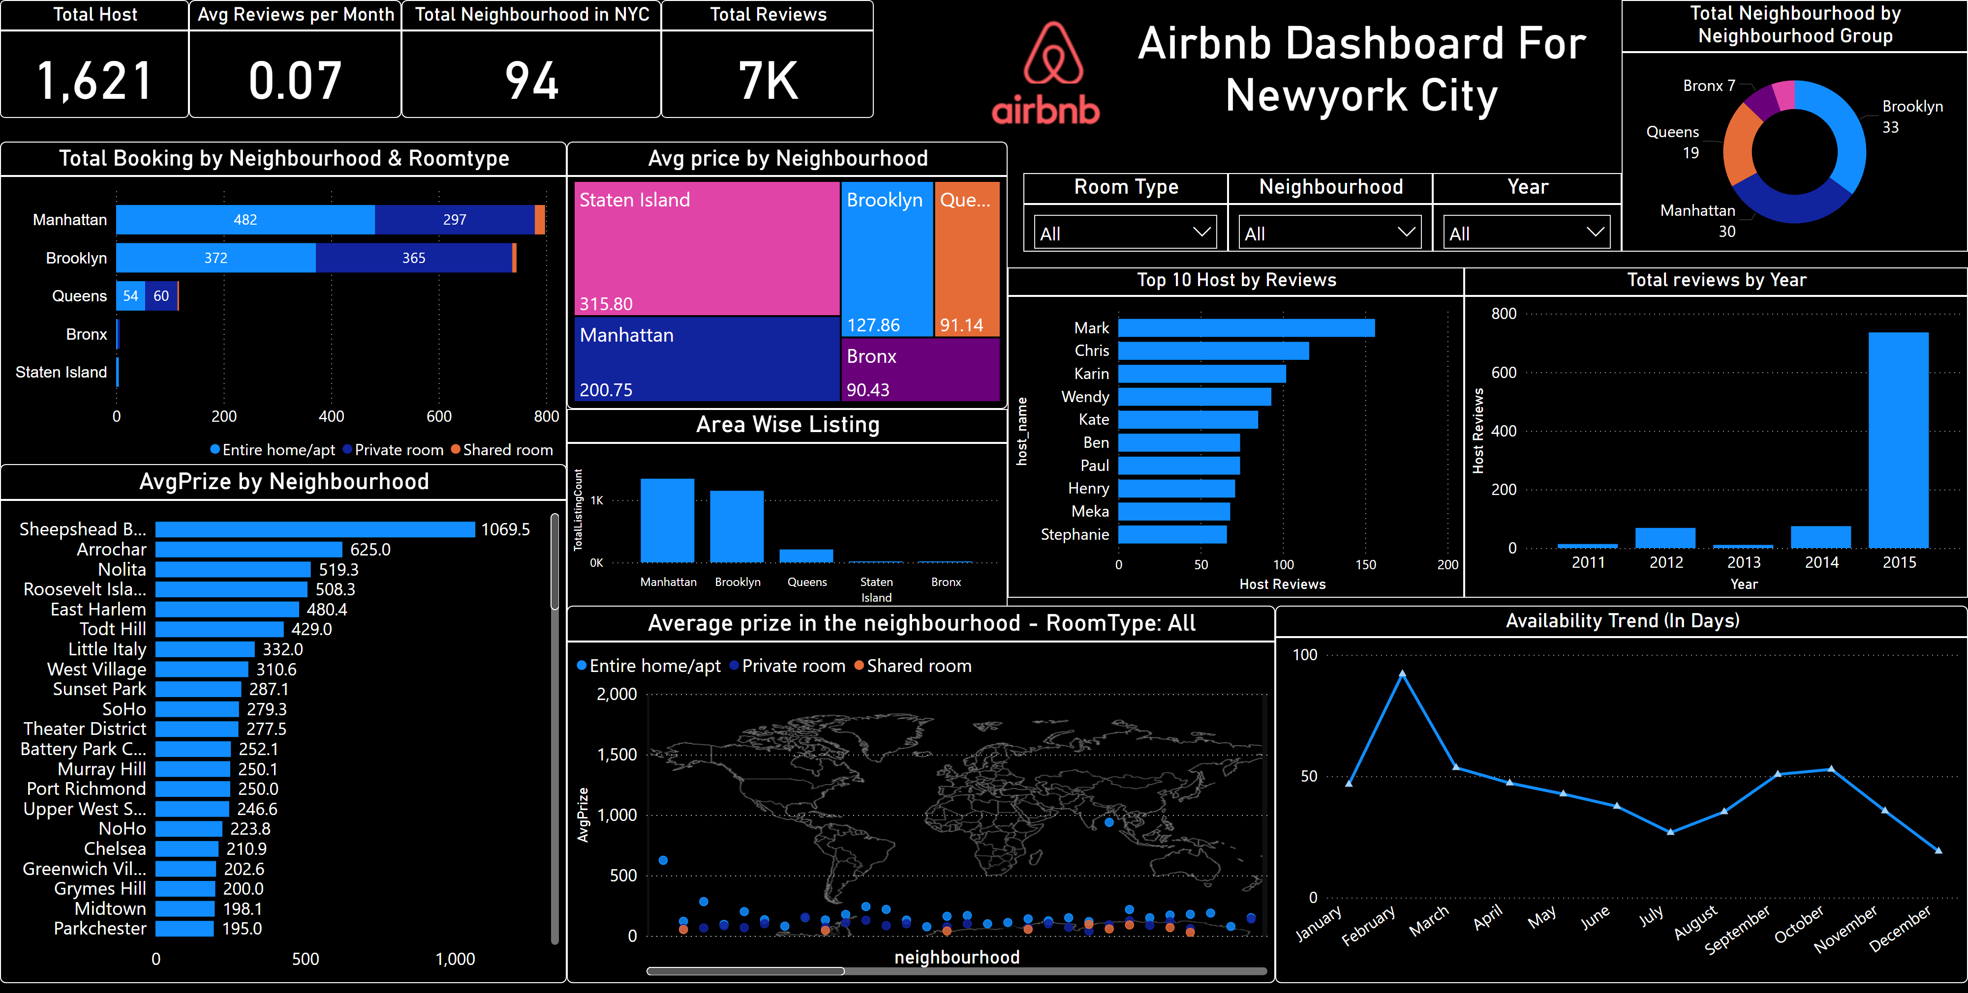
Page 1

